Slide 1

6th Grade Accelerated Math
Unit 3, Lesson 8 Comparing and Performing Operations with Absolute Value Volume 1, pg. 117

Slide 2


Benchmark
MA.6.NSO.1.4
Solve mathematical and real-world problems involving absolute value, including the comparison of absolute value.
volume 1, pg. 117

Slide 3
Integrated Mathematical Thinking and Reasoning Standards
MA.K12.MTR.2.1 Demonstrate understanding by representing problems in multiple ways.
MA.K12.MTR.4.1 Engage in discussions that reflect on the mathematical thinking of self and others.
MA.K12.MTR.6.1 Assess the reasonableness of solutions.
MA.K12.MTR.7.1 Apply mathematics to real-world contexts.
volume 1, pg. 117

Slide 4

Learning Targets
I can compare the absolute value of two numbers.
I can perform operations that involve the absolute values of two numbers.
volume 1, pg. 117

Slide 5

Warm-Up
volume 1, pg. 117

Slide 6
3.8.1 Warm-Up: Rational Numbers in the Real World
For each of the following problems, ask a classmate for his/her explanation. Once you have received their explanation, write a summary in the space provided in the box. Your classmate should read your summary and initial that it is correct.
Repeat this with a different classmate for each of the remaining problems.
volume 1, pg. 117

Slide 7

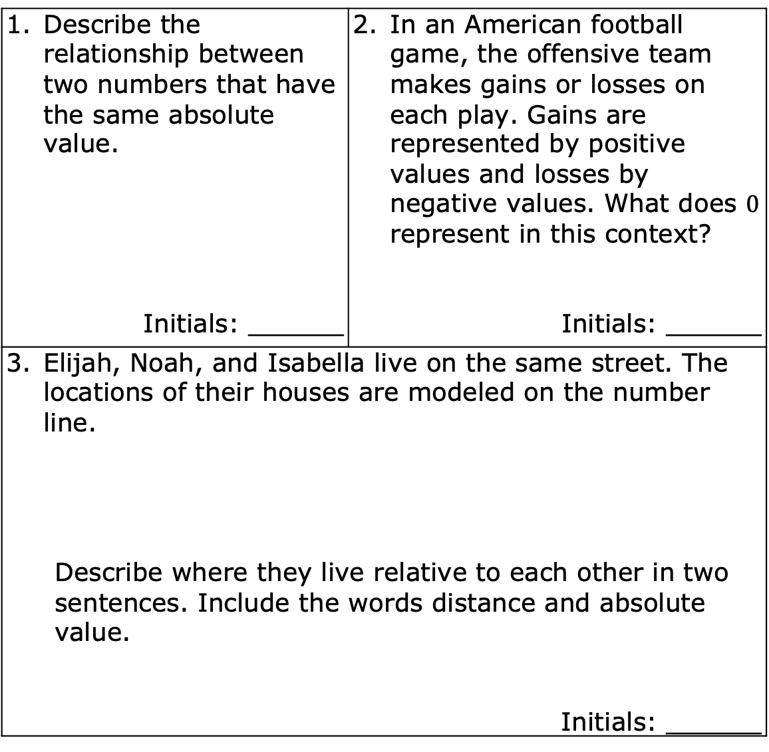
Describe the relationship between two numbers that have the same absolute value. Initials: ______ | In an American football game, the offensive team makes gains or losses on each play. Gains are represented by positive values and losses by negative values. What does $0$ represent in this context? Initials: ______
Elijah, Noah, and Isabella live on the same street. The locations of their houses are modeled on the number line. Describe where they live relative to each other in two sentences. Include the words distance and absolute value. Initials: ______
volume 1, pg. 117

Slide 8

Exploration
volume 1, pg. 118

Slide 9

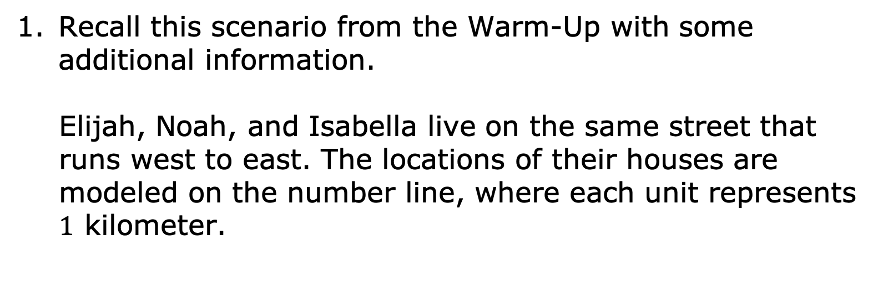
3.8.2 Exploration: Comparing and Interpreting Absolute Value in Context
Recall this scenario from the Warm-Up with some additional information.
Elijah, Noah, and Isabella live on the same street that runs west to east. The locations of their houses are modeled on the number line, where each unit represents $1$ kilometer.
WEST
EAST
volume 1, pg. 118

Slide 10
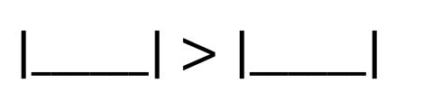

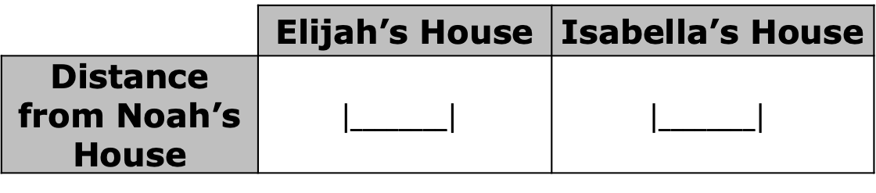
Noah’s house is located at $0$ on the number line model. Represent the distance from Noah’s house to both Isabella’s house and Elijah’s house using absolute value.
How do the absolute values in the table compare to each other?
 | Elijah’s House | Isabella’s House
Distance from Noah’s House | $$\left|________\right|$$ | $$\left|________\right|$$
volume 1, pg. 118

Slide 11
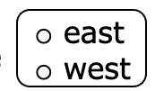
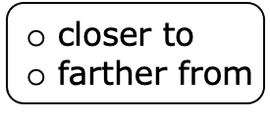
Isabella lives _____ kilometers to the
of Noah. Elijah lives ______ kilometers to the
of Noah. Isabella lives
Noah than Elijah does.
volume 1, pg. 118

Slide 12

Guided Instruction
volume 1, pg. 118

Slide 13

3.8.3 Guided Instruction: Comparing Absolute Values
A number line is shown with the integers $−7$, $−5$, $−3$, $2$, $4$, and $5$ plotted.
Discuss with your partner which statements are true. Be prepared to explain your thinking.
volume 1, pg. 118

Slide 14

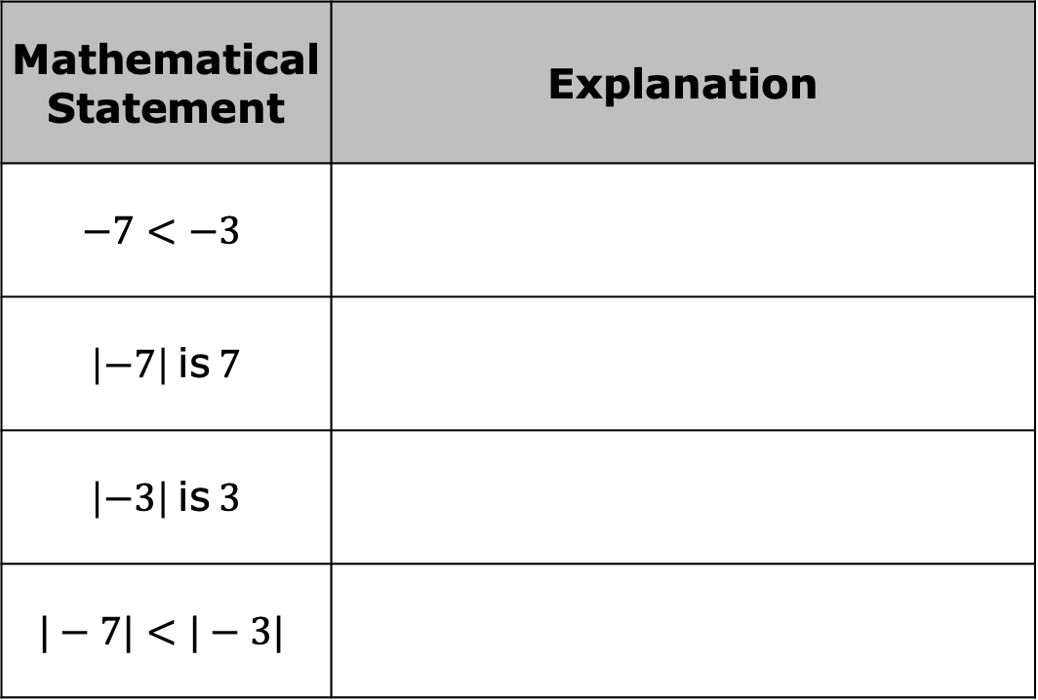
Does the comparison of $−7$ and $−3$ match the comparison of $|−7|$ and $|−3|$?
Mathematical Statement | Explanation
$$−7<−3$$
$\left|−7\right|$ is $7$
$\left|−3\right|$ is $3$
$$|−7|<|−3|$$
volume 1, pg. 118

Slide 15
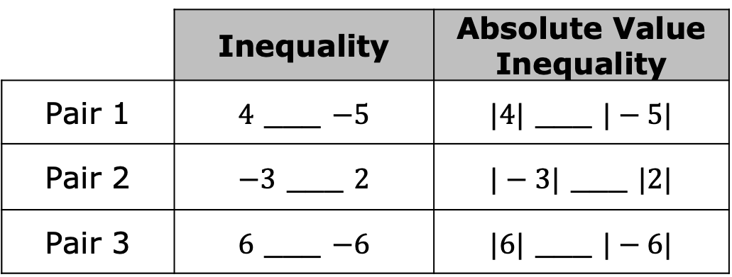
With your partner, discuss why comparing two negative values and comparing the absolute value of the same two negative numbers may be different. Summarize your discussion below.
For each row, use the symbols >, < , or = to compare each pair of values.
 | Inequality | Absolute Value Inequality
Pair 1 | $4$ ___ $−5$ | $|4|$ ___ $|−5|$
Pair 2 | $−3$ ___ $2$ | $|−3|$ ___ $|2|$
Pair 3 | $6$ ___ $−6$ | $|6|$ ___ $|−6|$
volume 1, pg. 119

Slide 16
What do you notice about the comparisons?
When comparing the absolute values of two
numbers, numbers that are closer to zero will
always have the __________ absolute value.
volume 1, pg. 119

Slide 17

Collaboration
volume 1, pg. 119

Slide 18

3.8.4 Collaboration: Inequality Mix and Match
Work with your partner to complete the table.
Partner A will select two numbers and one comparison symbol. At least one of the numbers must be written as an absolute value.
Partner B will then write the mathematical statement in words. The following phrases may be helpful: is equal to, the absolute value of, is greater than, is less than.
Switch roles until each partner has taken two turns. An example is shown in the first row.
volume 1, pg. 119

Slide 19
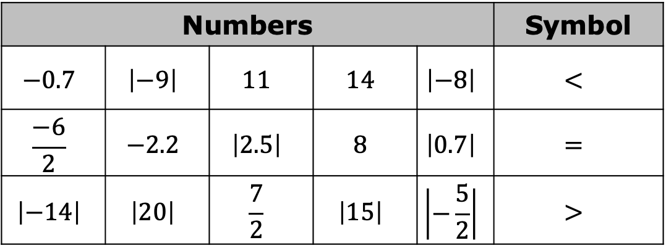
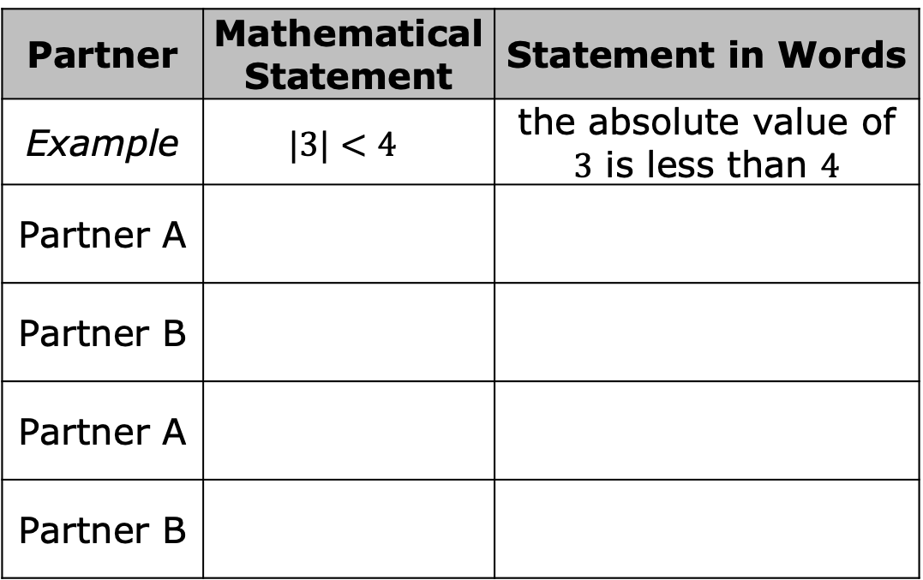
Numbers |  |  |  |  | Symbol
$$−0.7$$ | $$\left|−9\right|$$ | $$11$$ | $$14$$ | $$\left|−8\right|$$ | $<$
$$\frac{−6}{2}$$ | $$−2.2$$ | $$\left|2.5\right|$$ | $$8$$ | $$\left|0.7\right|$$ | $$=$$
$$\left|−14\right|$$ | $$\left|20\right|$$ | $$\frac{7}{2}$$ | $$\left|15\right|$$ | $$\left|−\frac{5}{2}\right|$$ | $>$
Partner | Mathematical Statement | Statement in Words
Example | $$|3|<4$$ | the absolute value of $3$ is less than $4$
Partner A
Partner B
Partner A
Partner B
volume 1, pg. 119

Slide 20
Guided Instruction
volume 1, pg. 120

Slide 21
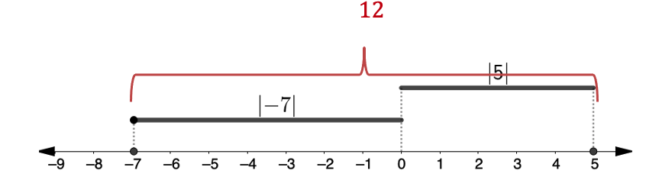
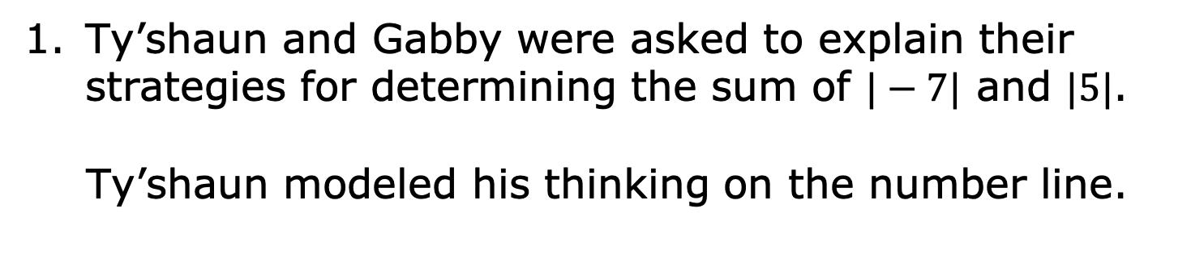
3.8.5 Guided Instruction: Operations Using Absolute Value
Ty’shaun and Gabby were asked to explain their strategies for determining the sum of $|−7|$ and $|5|$.
Ty’shaun modeled his thinking on the number line.
volume 1, pg. 120

Slide 22
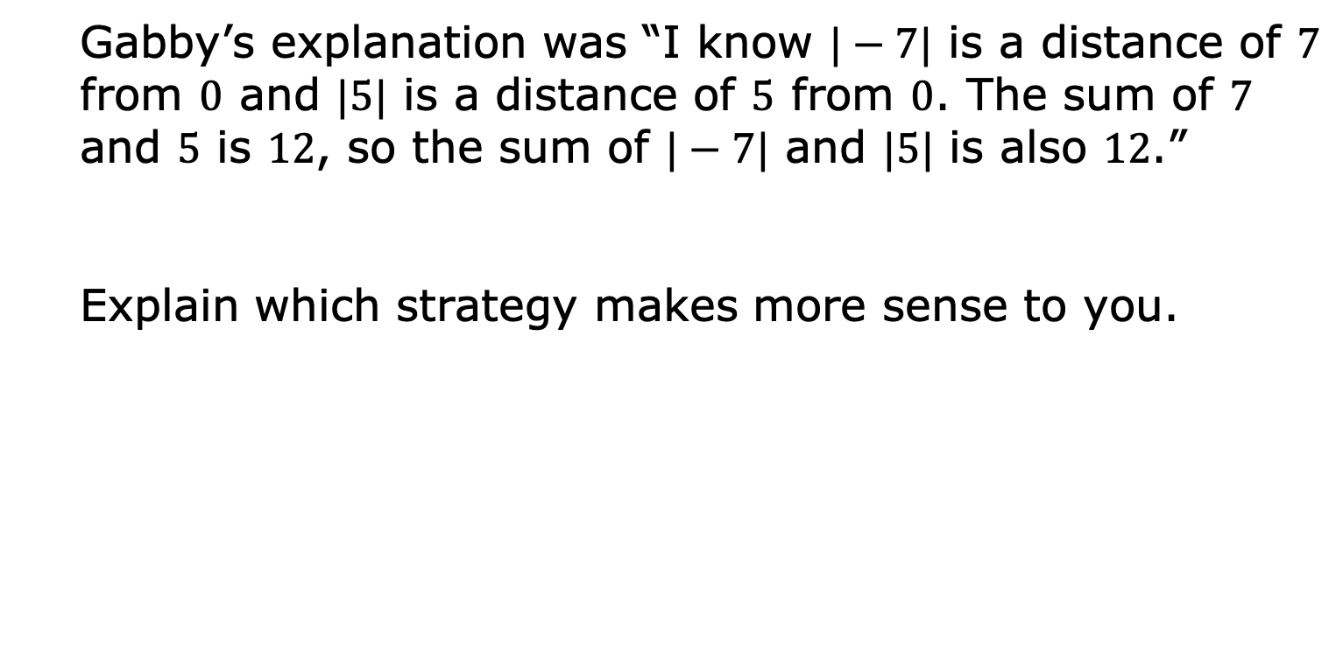
Gabby’s explanation was “I know $|−7|$ is a distance of $7$ from $0$ and $|5|$ is a distance of $5$ from $0$. The sum of $7$ and $5$ is $12$, so the sum of $|−7|$ and $|5|$ is also $12$.”
Explain which strategy makes more sense to you.
volume 1, pg. 120

Slide 23

Find the value of each expression.
$\left|−18\right|−\left|−13\right|$ b. $12×\left|−4\right|$
$\frac{\left|45\right|}{\left|−3\right|}$ d. $\left|−22\right|+\left|31\right|+\left|40\right|$
volume 1, pg. 120

Slide 24

Your Turn
volume 1, pg. 121

Slide 25
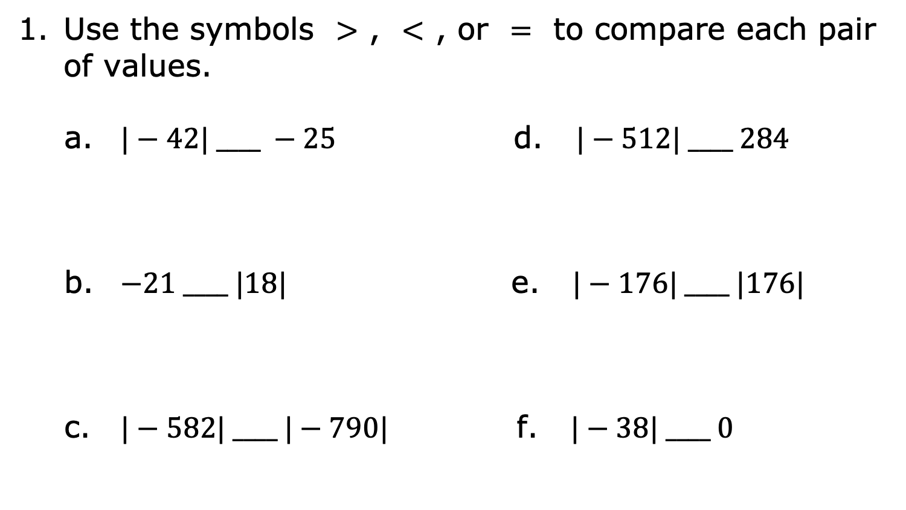
3.8.6 Your Turn!
Use the symbols $>$ , $<$ , or $=$ to compare each pair of values.
$|−42| ____ −25$ d. $|−512| ____ 284$
$−21 ____ |18|$ e. $|−176| ____ |176|$
$|−582| ____ |−790|$ f. $|−38| ____ 0$
volume 1, pg. 121

Slide 26
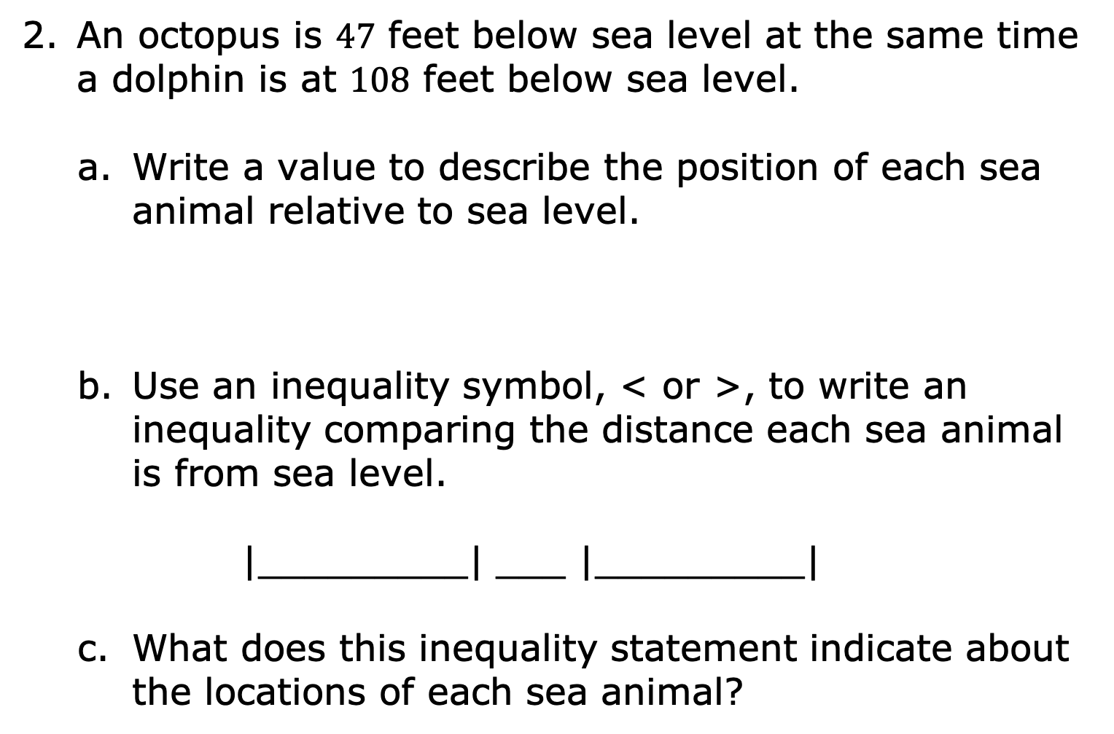
An octopus is $47$ feet below sea level at the same time a dolphin is at $108$ feet below sea level.
Write a value to describe the position of each sea animal relative to sea level.
Use an inequality symbol, < or >, to write an inequality comparing the distance each sea animal is from sea level.
|_________| ___ |_________|
What does this inequality statement indicate about the locations of each sea animal?
Octopus | Dolphin
volume 1, pg. 121

Slide 27

Find the value of each expression.
$|−58|+12=________$
$|−13 |×5=________$
$\frac{\left|−36\right|}{9} =________$
volume 1, pg. 121

Slide 28

Wrap-Up
volume 1, pg. 122

Slide 29
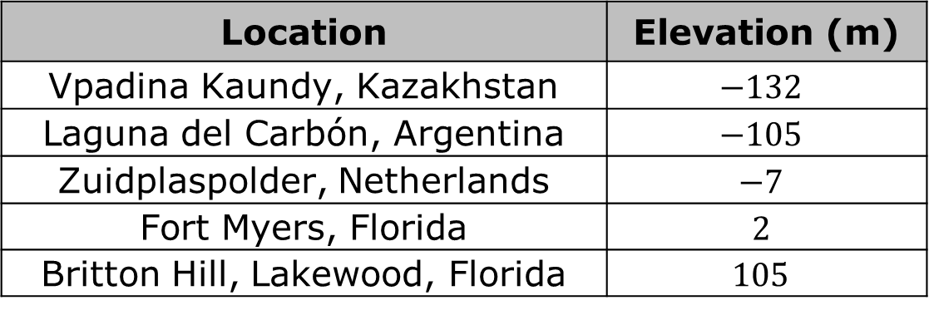
3.8.7 Wrap-Up: Ticket Out the Door
The table shows the elevation, in meters (m), of five locations.
Location | Elevation (m)
Vpadina Kaundy, Kazakhstan | $$−132$$
Laguna del Carbón, Argentina | $$−105$$
Zuidplaspolder, Netherlands | $$−7$$
Fort Myers, Florida | $$2$$
Britton Hill, Lakewood, Florida | $$105$$
volume 1, pg. 122

Slide 30
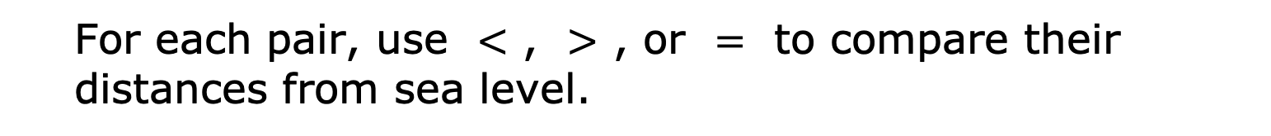
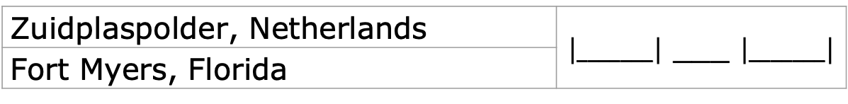
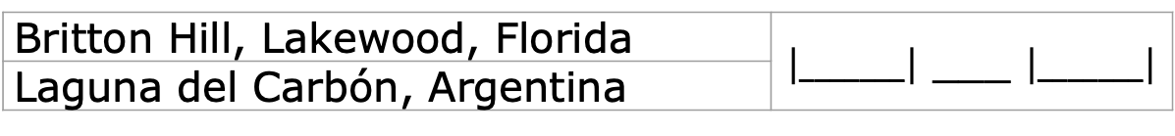
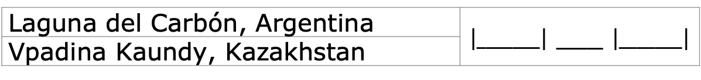
For each pair, use $<$ , $>$ , or $=$ to compare their distances from sea level.
Zuidplaspolder, Netherlands | $\left|_______\right|$ ___ $\left|_______\right|$
Fort Myers, Florida
Britton Hill, Lakewood, Florida | $\left|_______\right|$ ___ $\left|_______\right|$
Laguna del Carbón, Argentina
Laguna del Carbón, Argentina | $\left|_______\right|$ ___ $\left|_______\right|$
Vpadina Kaundy, Kazakhstan
volume 1, pg. 122

